Slide 1
Lesson objective
Title: Full Circle
Aim:
Calculate circumference and area of semi, quarter and three-quarter circles.
Calculate area of a trapezium
Plan:
Review Area and perimeter of basic shapes
Adjusting formula

Slide 2
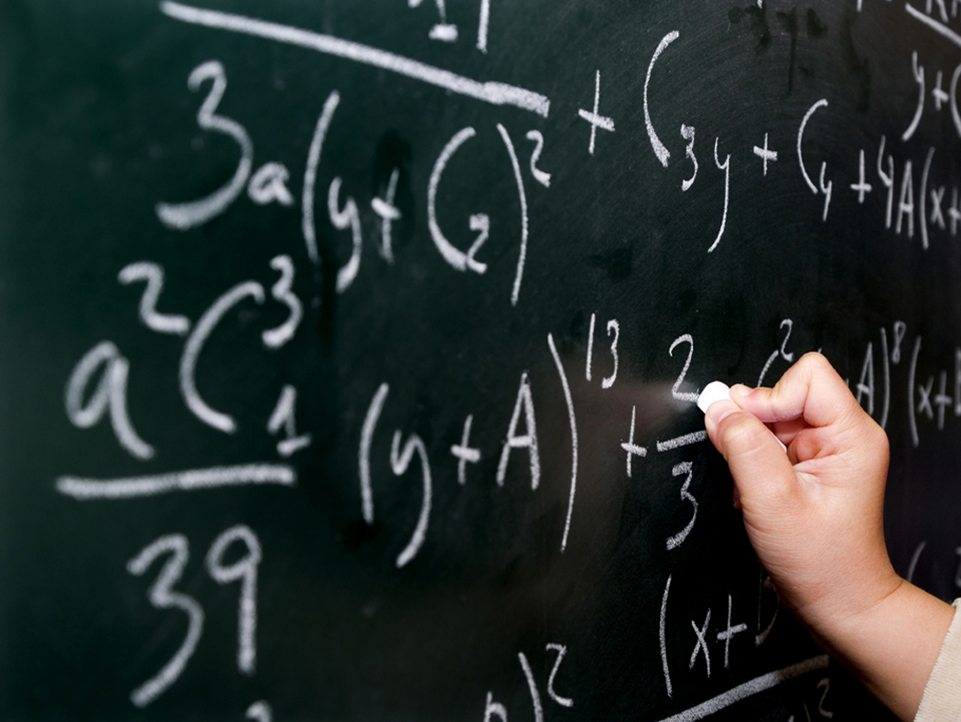
3
Answers:
220cm²
115cm²
221cm²
289cm²
48cm²
525cm²
608cm²
104.5cm²
256cm²
504cm²
2
1
17cm
20cm
10cm
4
11cm
11.5cm
13cm
17cm
5
6
7
9cm
21cm
6cm
19cm
15cm
8cm
32cm
25cm
9
8
10
14cm
16cm
21cm
11cm
19cm
16cm
24cm

Slide 3
Circles refresh
Find the area and circumference.
8cm
21cm

Slide 4
Circles refresh
Find the area and circumference.
Exercise books!
11cm
15cm

Slide 5
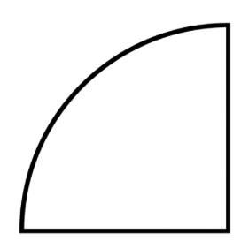
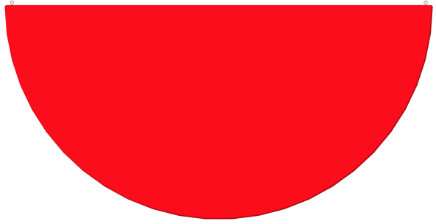

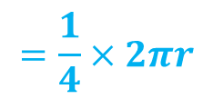


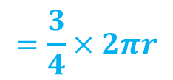
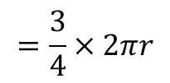


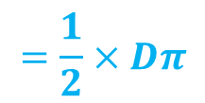
Circumference – part of a circle
The curved part:
The perimeter:
$$=\frac{1}{4}×2πr$$
5m
$$+ 2r$$
$$=\frac{1}{4}×2πr$$
12m
$$=\frac{1}{2}×Dπ$$
$$+ D$$
$$=\frac{1}{2}×2πr$$
$$=\frac{3}{4}×2πr$$
$$+ 2r$$
3m
$$=\frac{3}{4}×2πr$$

Slide 6
Practice activity

Slide 7



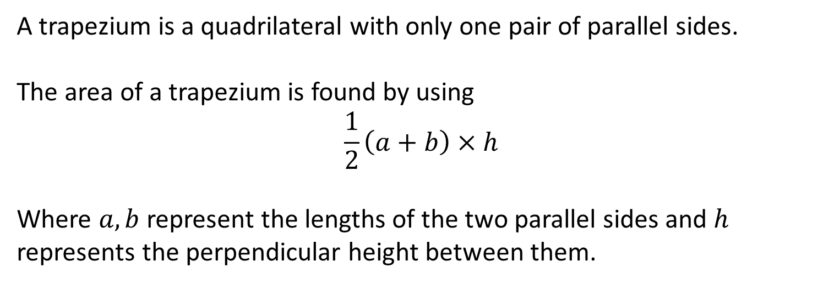






Area of a trapezium
A trapezium is a quadrilateral with only one pair of parallel sides.
The area of a trapezium is found by using
$$\frac{1}{2}\left(a+b\right)×h$$
Where $a,b$ represent the lengths of the two parallel sides and $h$ represents the perpendicular height between them.
This is on our notes page!
$$a$$
$$a$$
$$h$$
$$h$$
$$b$$
$$a$$
$$b$$
$$h$$
$$b$$

Slide 8

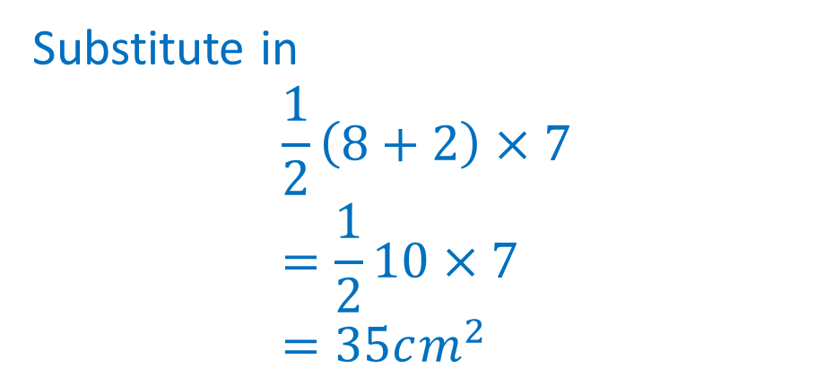




Area of a trapezium - example
Find the area of the trapezium below
Identify perpendicular heights
$$12cm$$
Substitute in
$$\frac{1}{2}\left(8+2\right)×7 \\ =\frac{1}{2}10×7 \\ =35cm^{2}$$
$$8cm$$
$$7cm$$
$$2cm$$
$$6cm$$

Slide 9





Area of a trapezium - practice
Find the area of the trapezium below.
Identify perpendicular heights
$$4cm$$
$$14cm$$
$$9cm$$
$$8cm$$
$$16cm$$

Slide 10
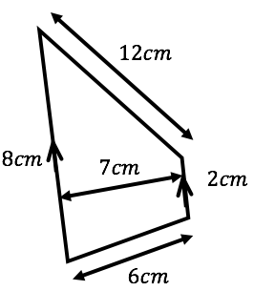
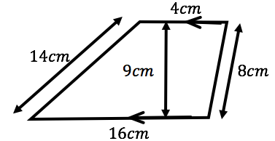
Area of a trapezium

